Slide 1
Lending Club Case Study
EDA with Python

Slide 2
Problem Statement
To understand the driving factors (or driver variables) behind loan default, i.e. the variables which are strong indicators of default. This knowledge can then be utilised for portfolio and risk assessment. er text for the problem statement

Slide 3
Analysis approach
Use EDA to uncover the most important patterns in this data set (loan data). We will use univariate and bi-variate analysis to formulate a hypothesis that can then be used to make sense of it.

Slide 4
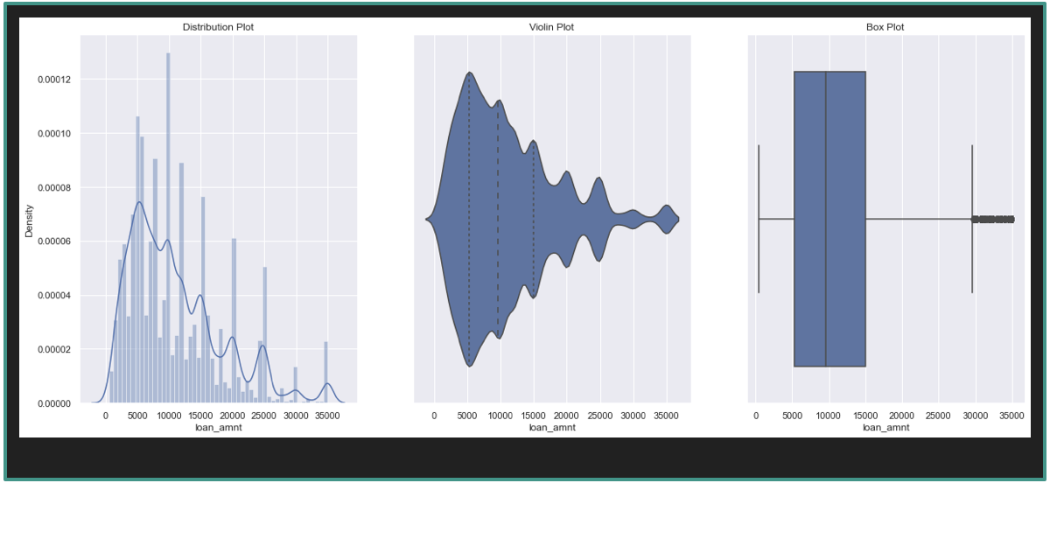
Univariate Analysis - 1

Slide 5
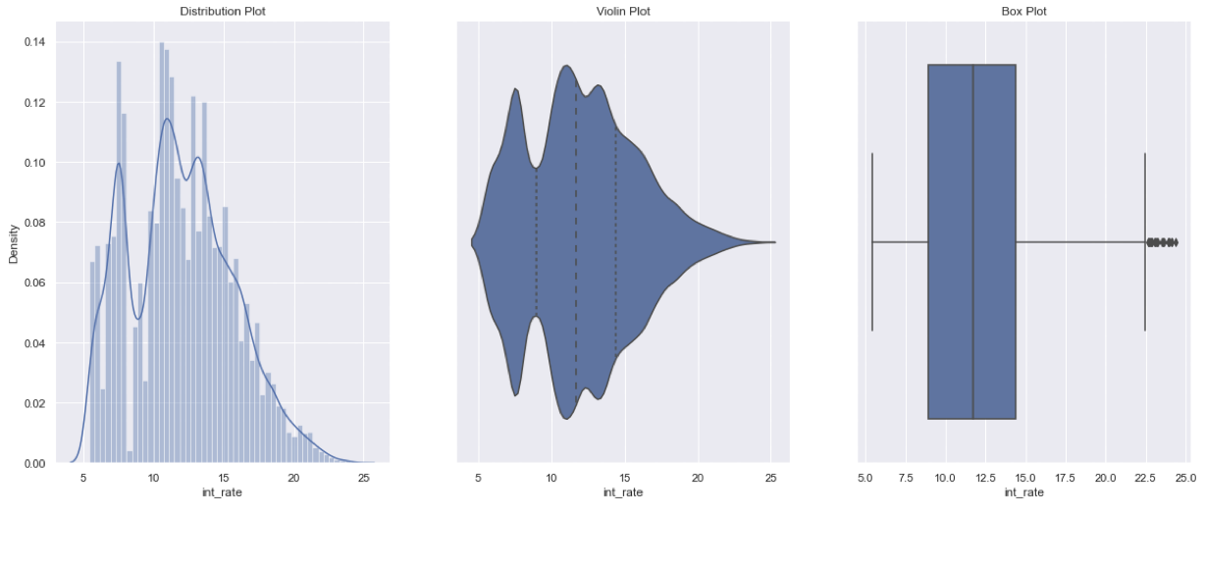
Univariate Analysis - 2

Slide 6
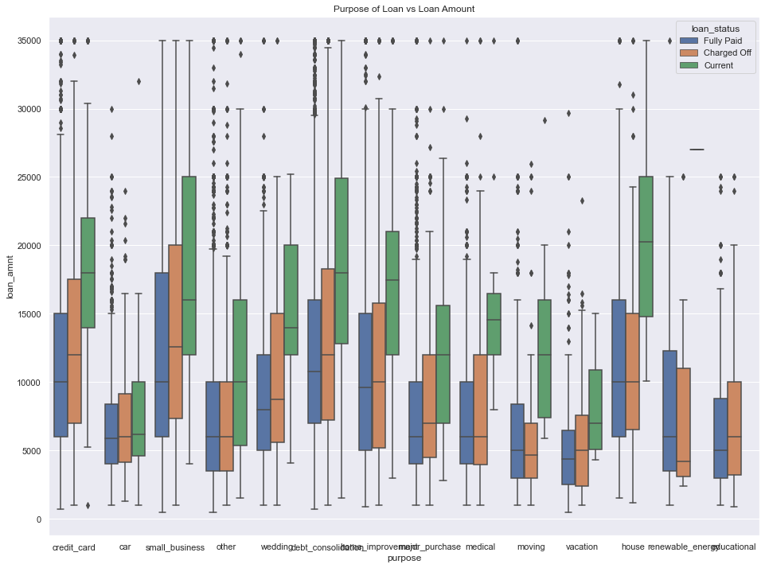
Bivariate Analysis

Slide 7
Conclusions
The most important predictors for default are: employment length, status of the loan, Interest rate and ownership. These can be used for effective prediction.

